Slide 1
Implementing
multi layer perceptron
with MNIST

Slide 11
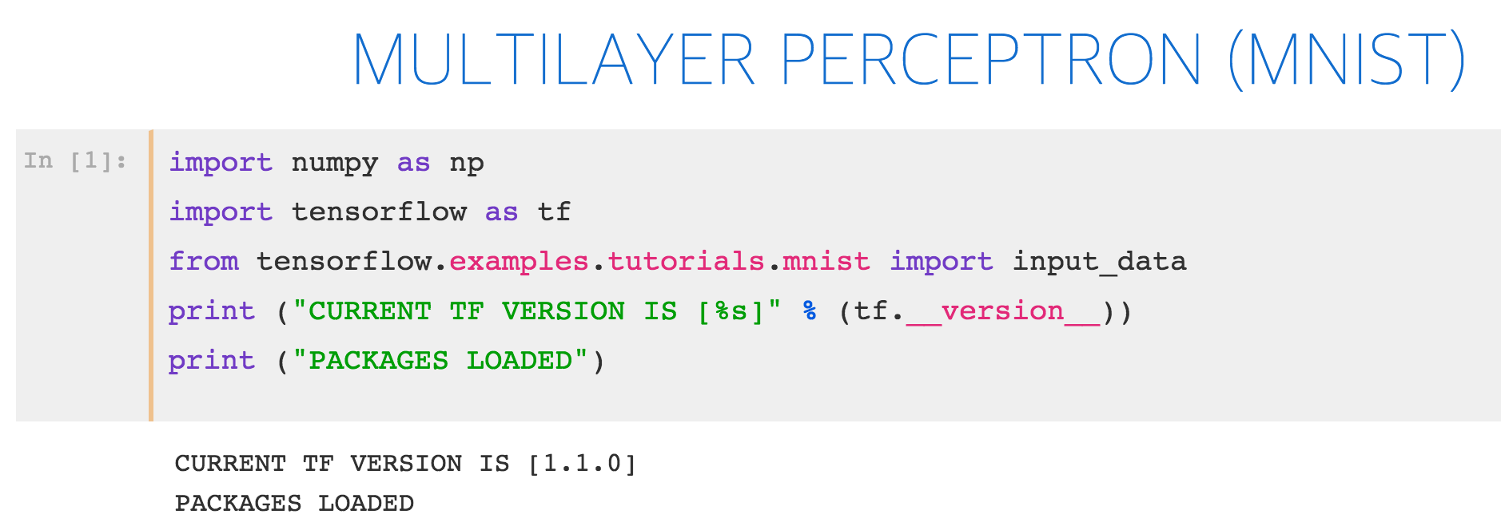
Notes:
import numpy as np
import tensor flow as tf
import matplotlib.pyplot as plt
from tensorflow.examples.tutorials.mnist
import input_data
%matplotlib inline print ("PACKAGES LOADED")

Slide 12
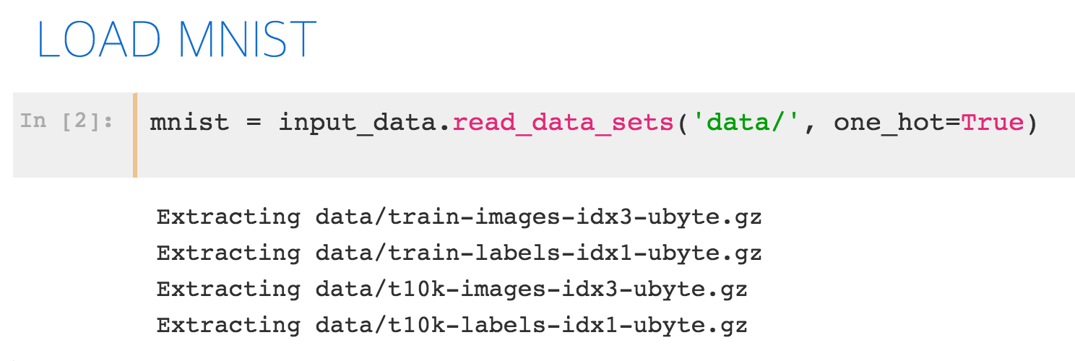
Notes:
import numpy as np
import tensor flow as tf
import matplotlib.pyplot as plt
from tensorflow.examples.tutorials.mnist
import input_data
%matplotlib inline print ("PACKAGES LOADED")

Slide 13
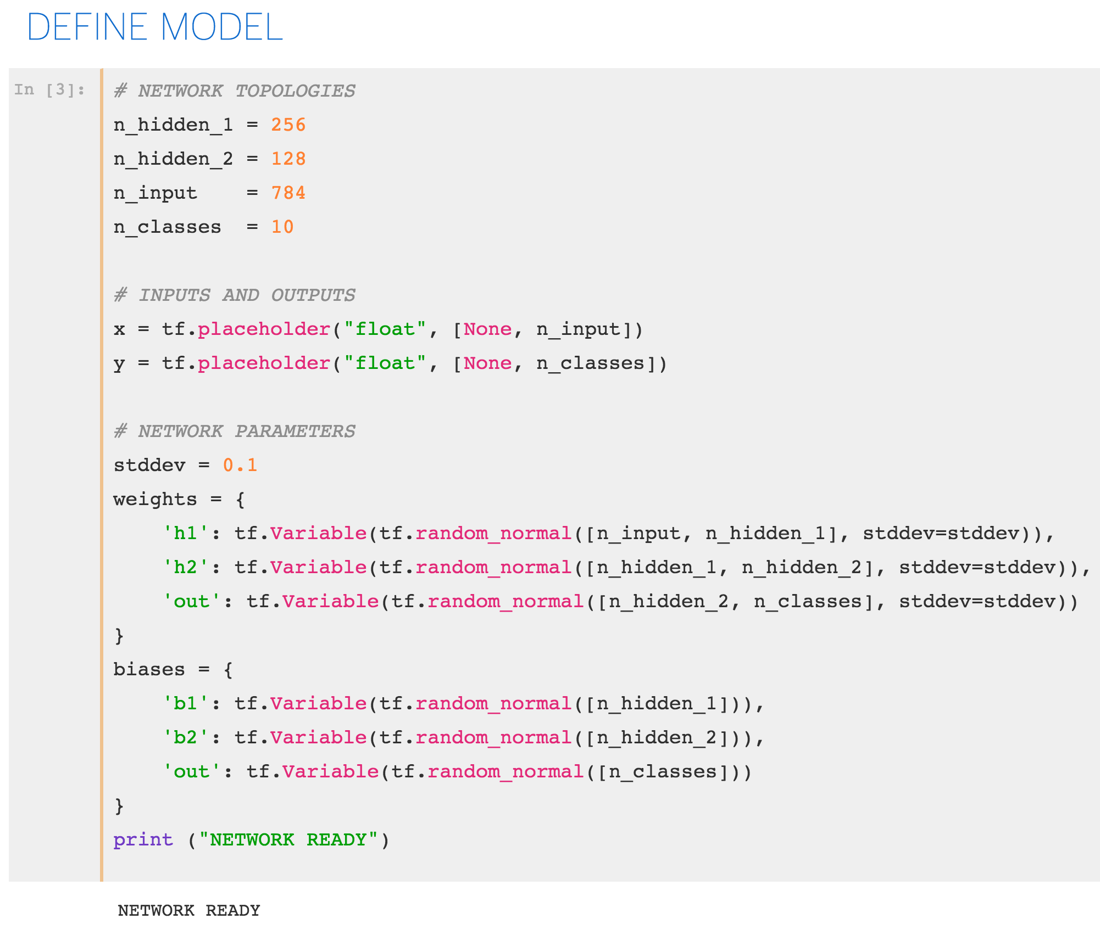
Notes:
import numpy as np
import tensor flow as tf
import matplotlib.pyplot as plt
from tensorflow.examples.tutorials.mnist
import input_data
%matplotlib inline print ("PACKAGES LOADED")

Slide 14
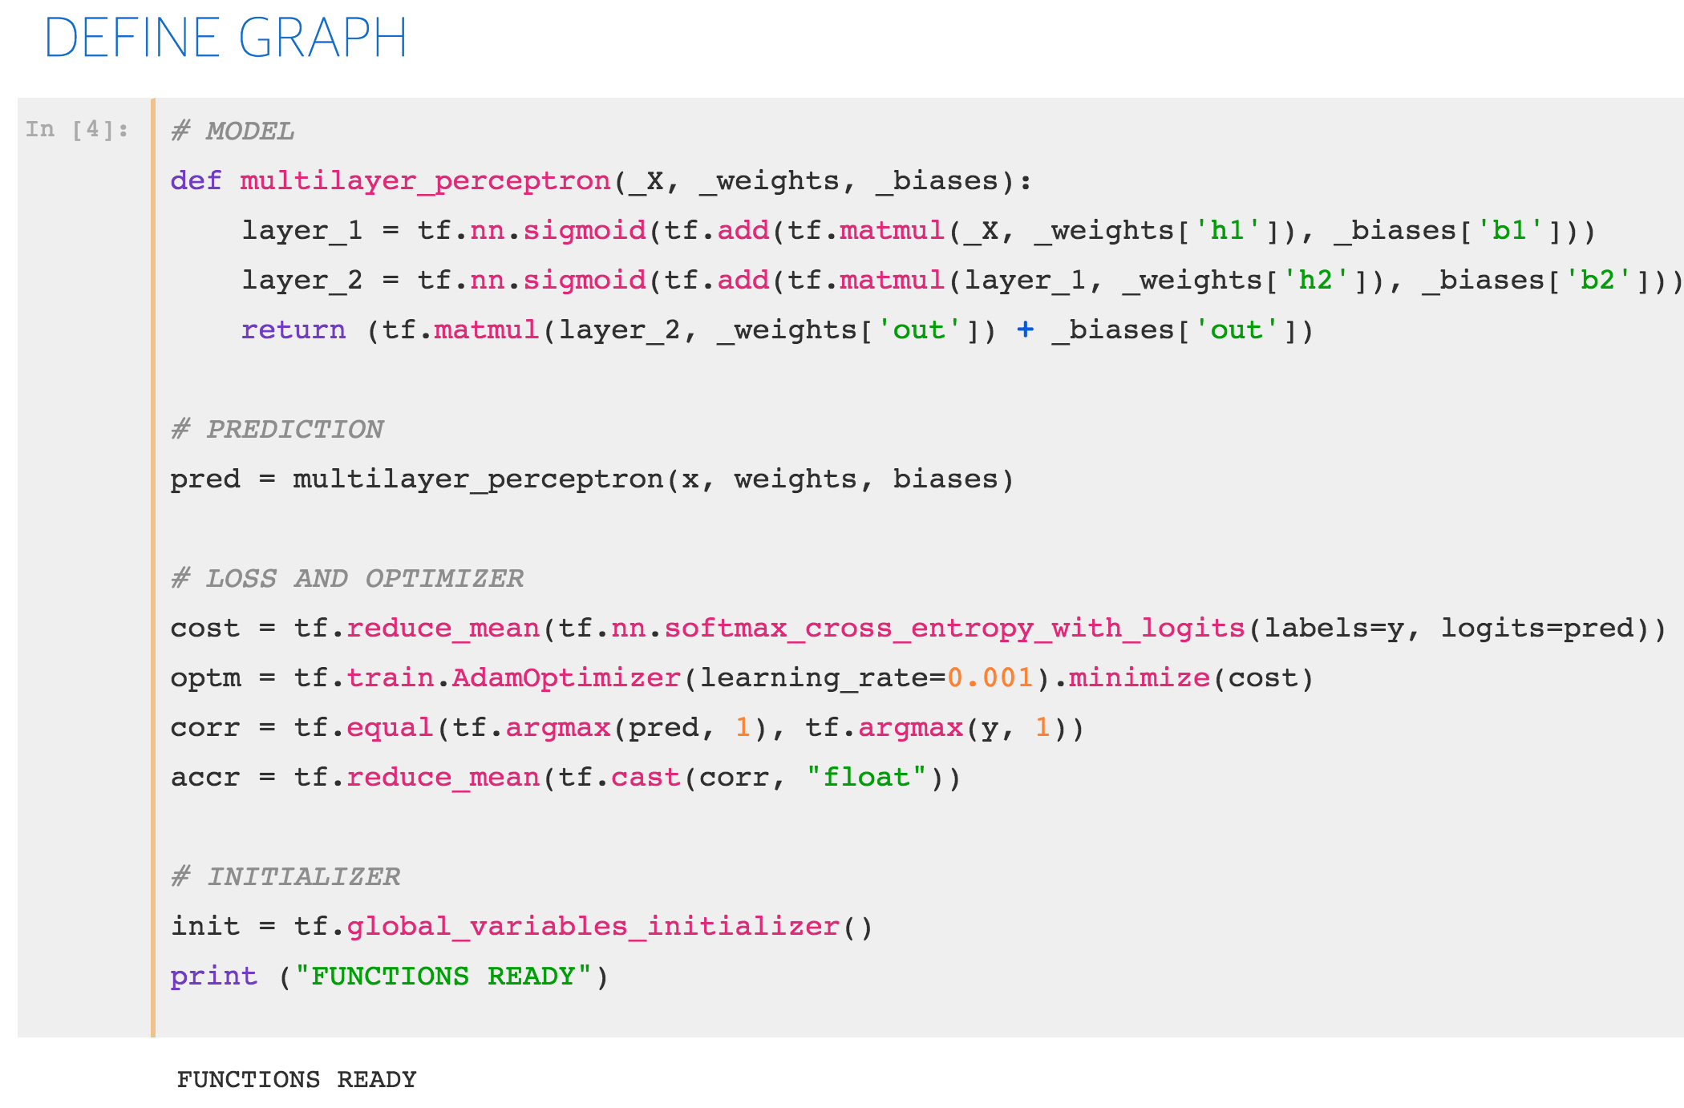

Slide 15
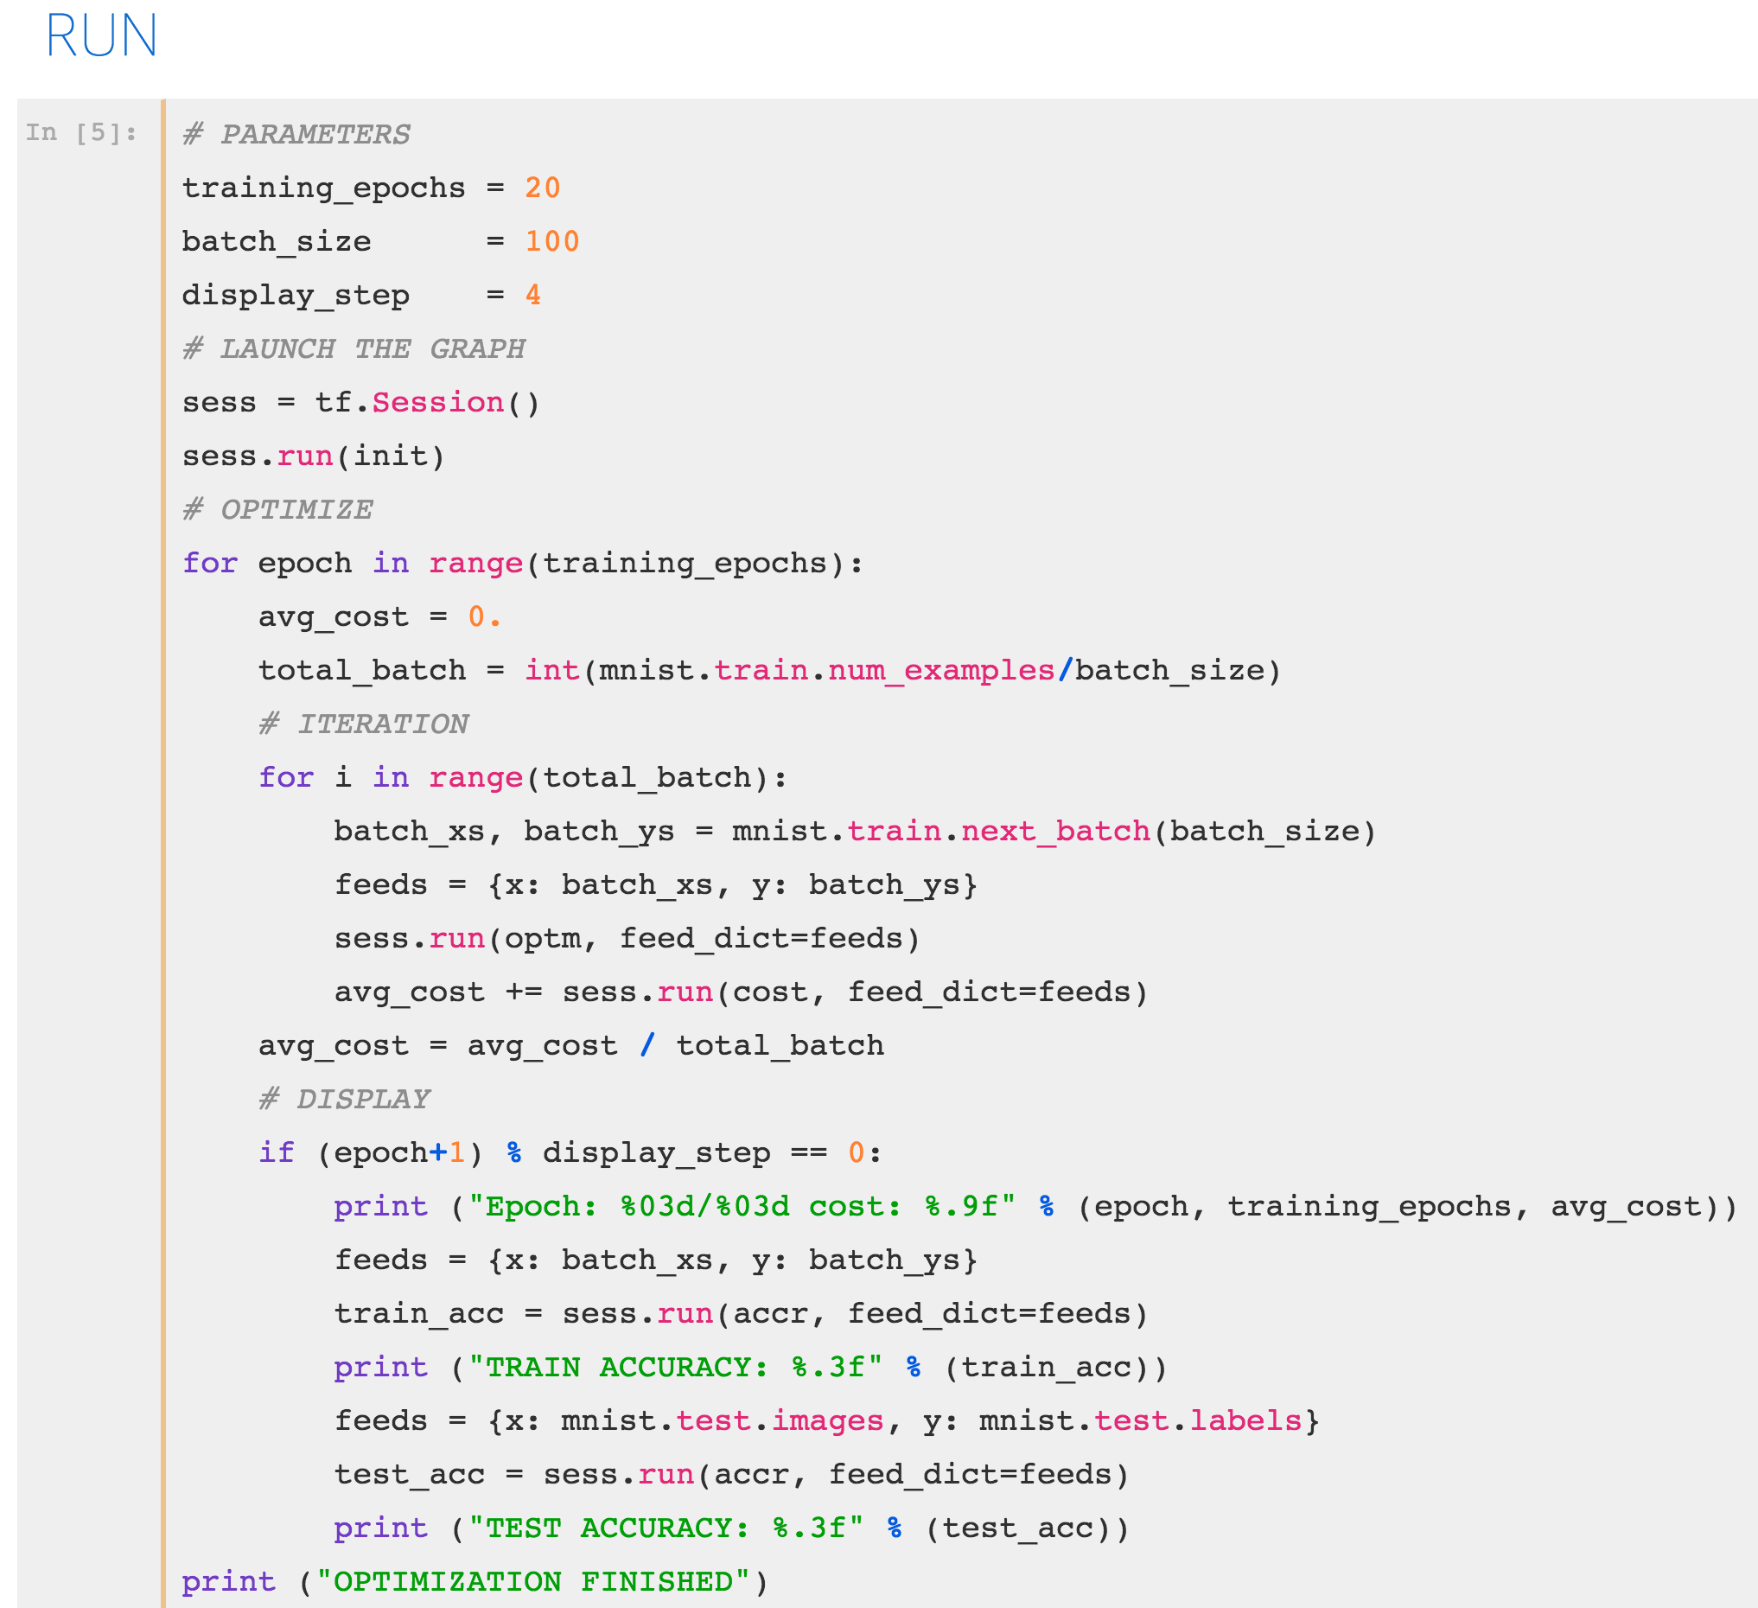

Slide 16
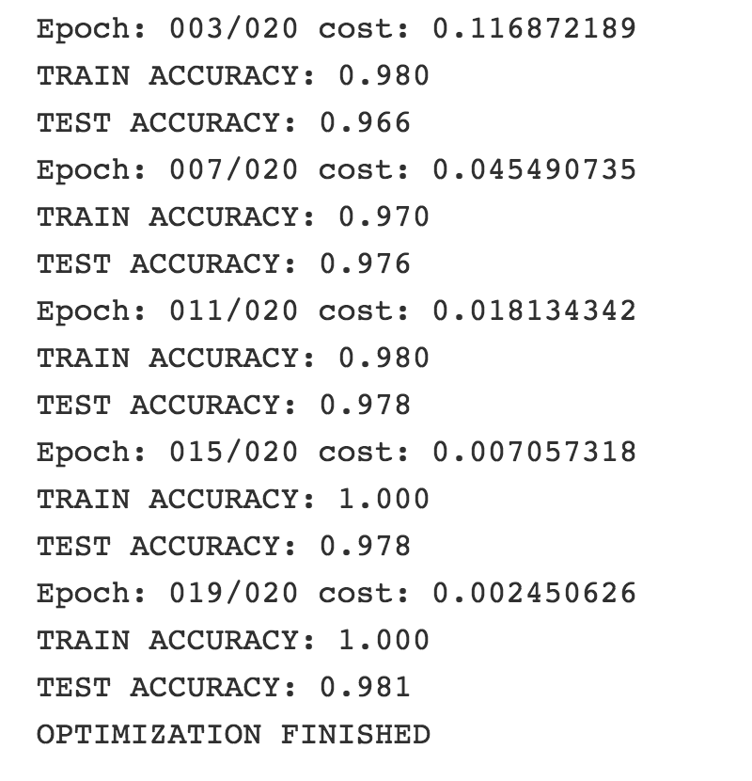

Slide 17
Implementing
multi layer perceptron
with custom data

Slide 18
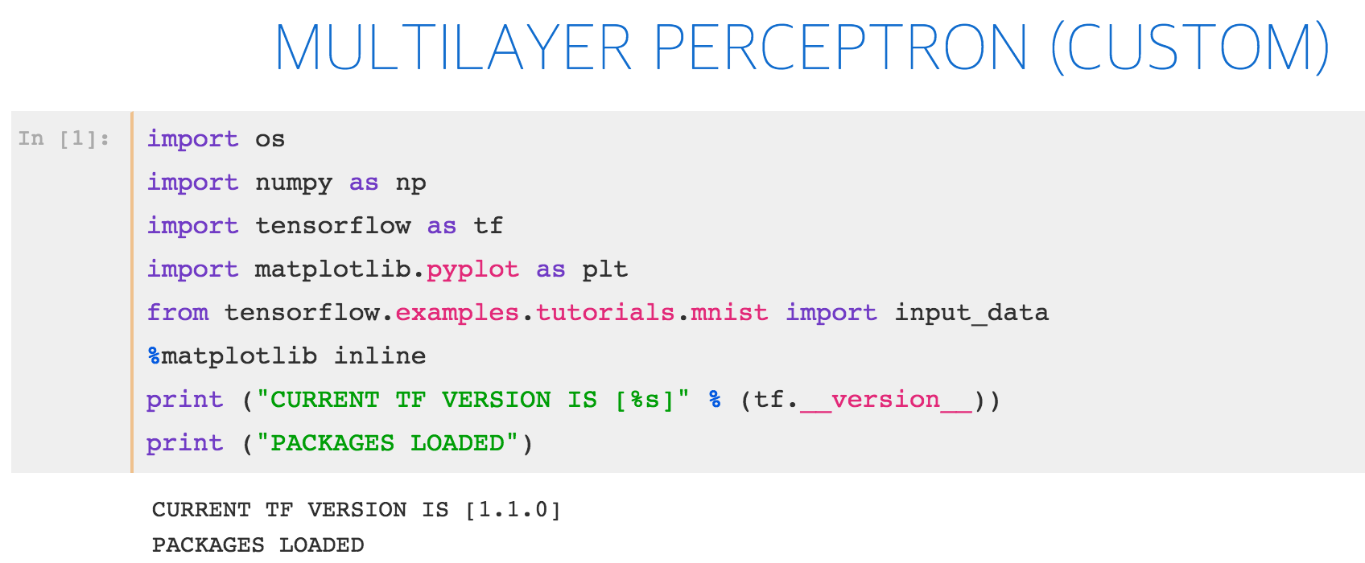

Slide 19
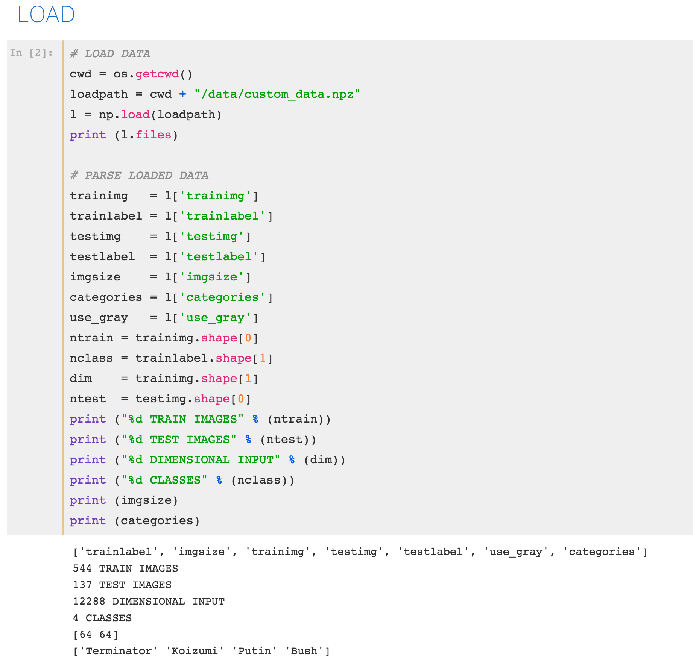

Slide 20
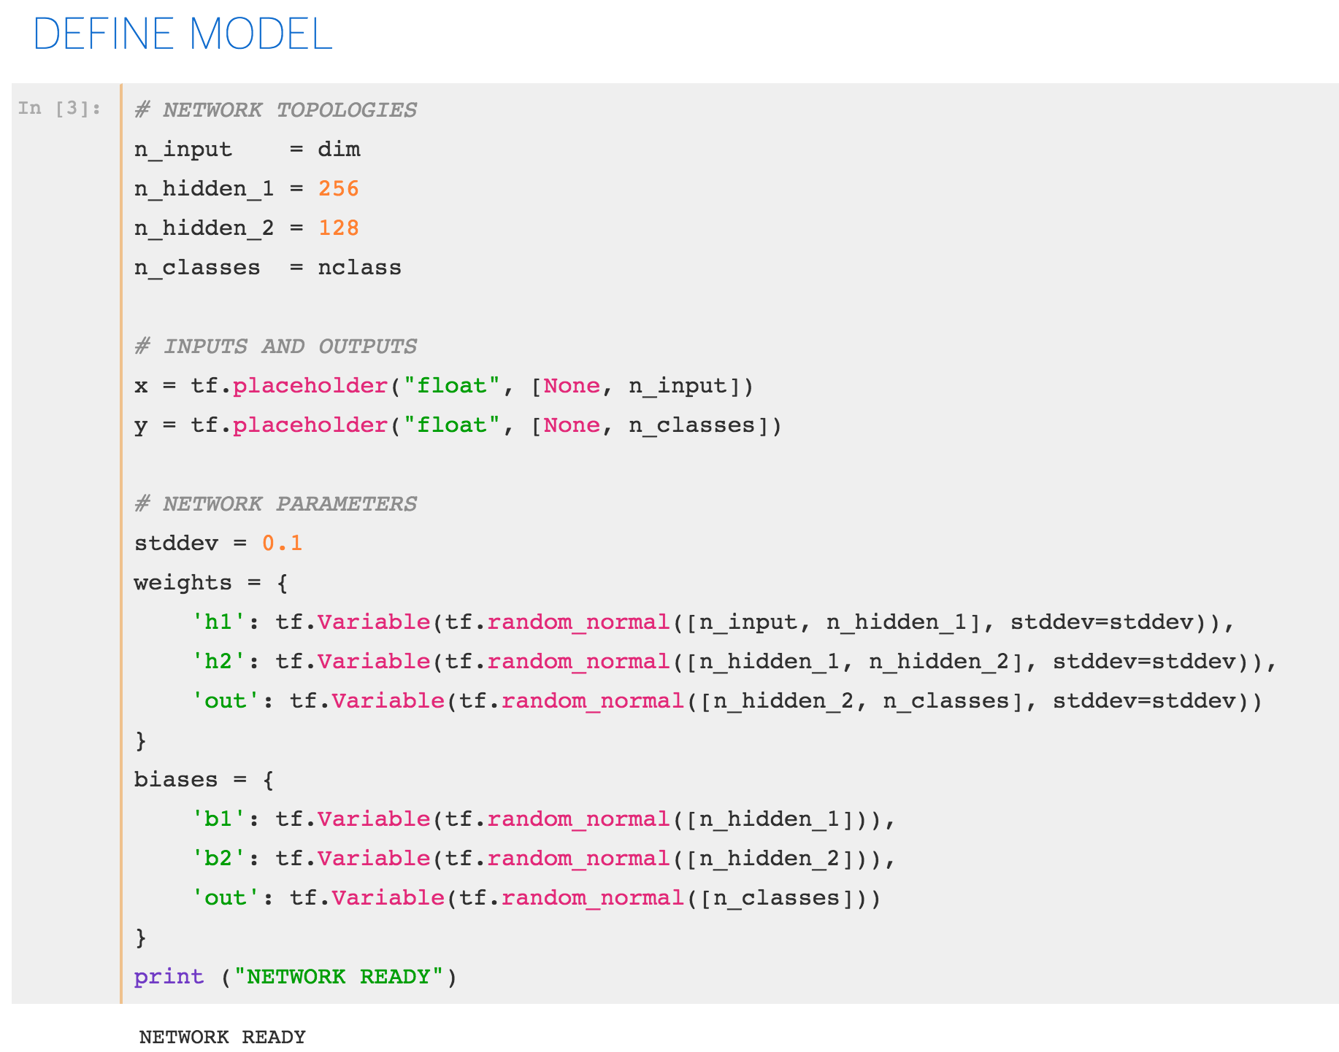

Slide 21
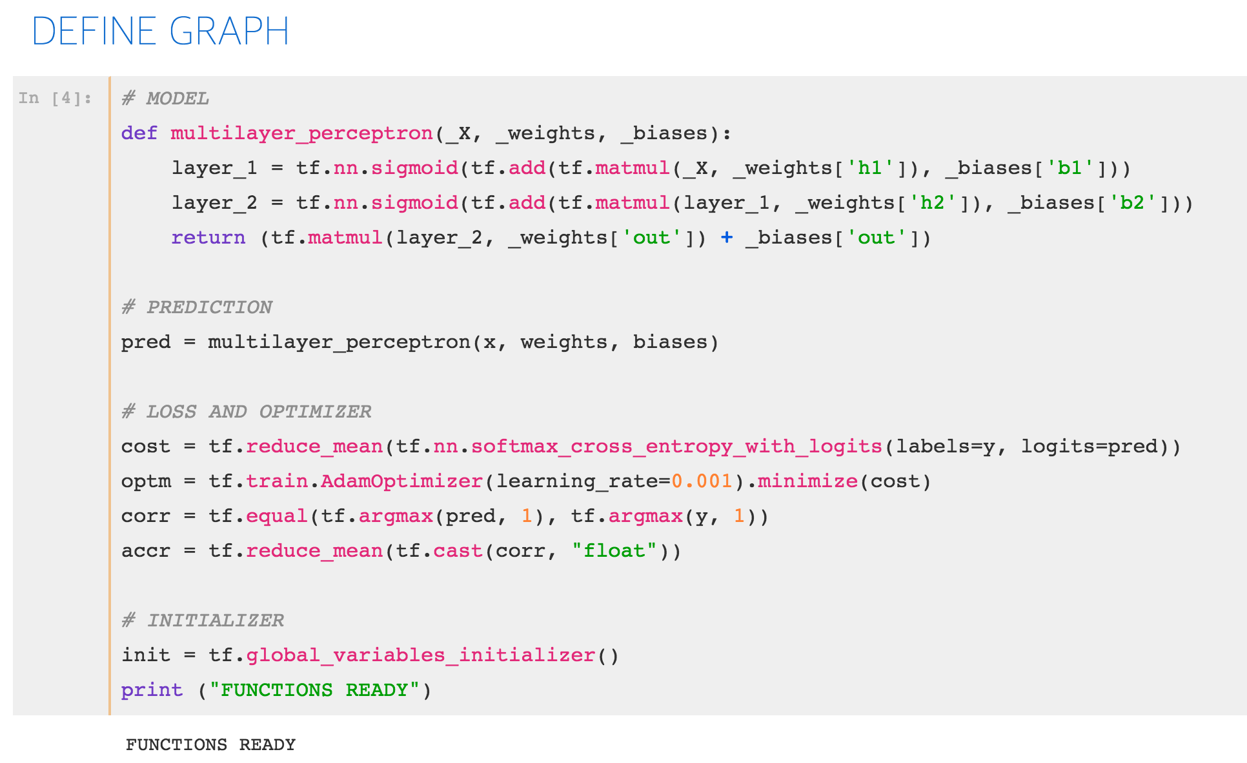

Slide 22
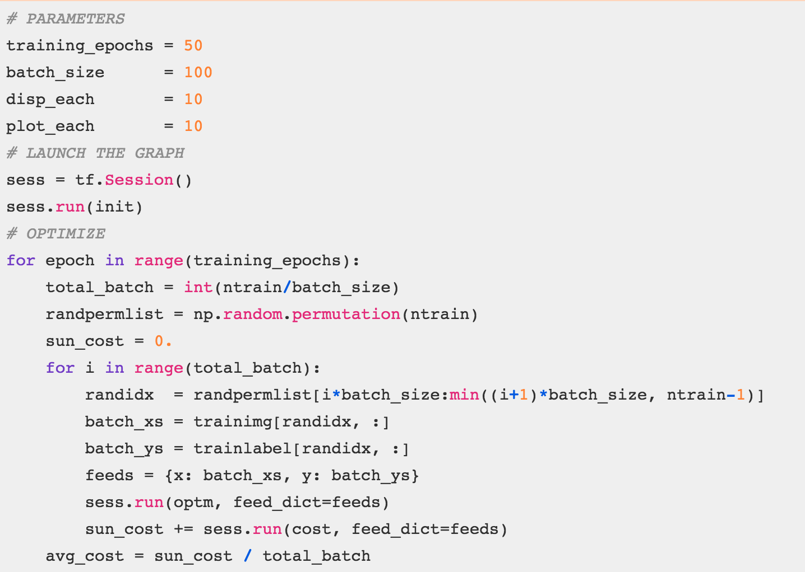

Slide 23
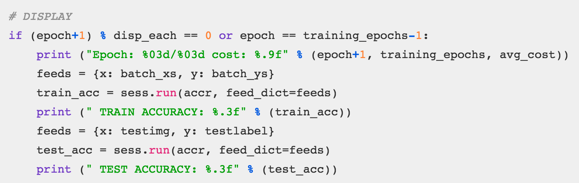

Slide 24
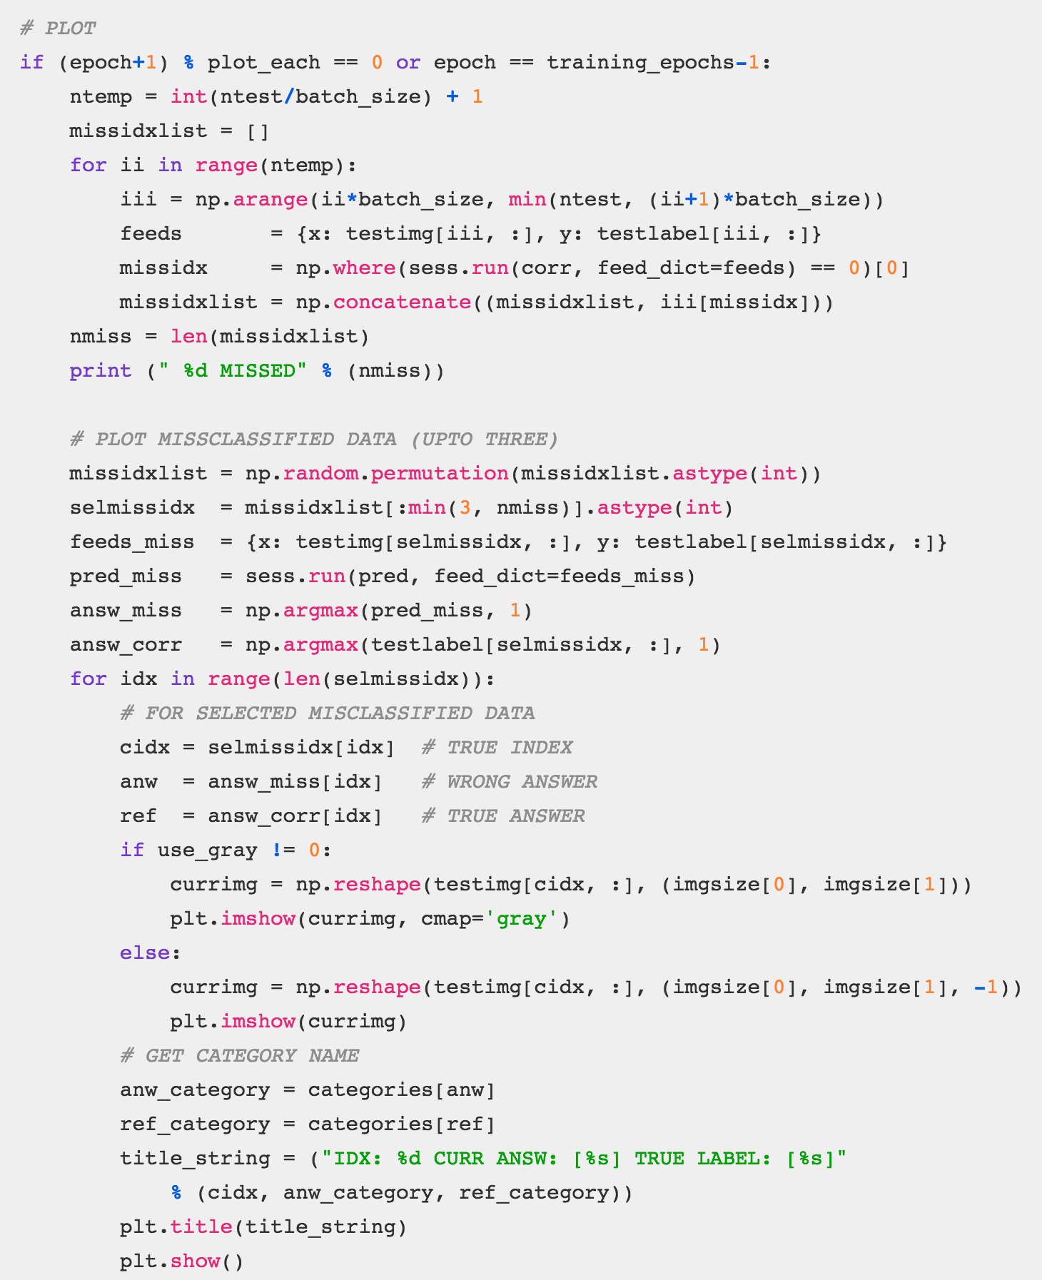

Slide 25
